Slide 1

Rights and Freedoms - Union N.L.E.
Monitoring deployment of 1:1 Education in Georgia
Jan’12 – Sep’12
Prehistory
School Director Research Results
Teacher Research Results
Visiting Schools
Highlighted Issues
Teacher Trainings Monitoring
Training Evaluation Research Results

Slide 2
Rights and Freedoms - Union N.L.E.
Monitoring deployment of 1:1 Education in Georgia
Prehistory

Slide 3
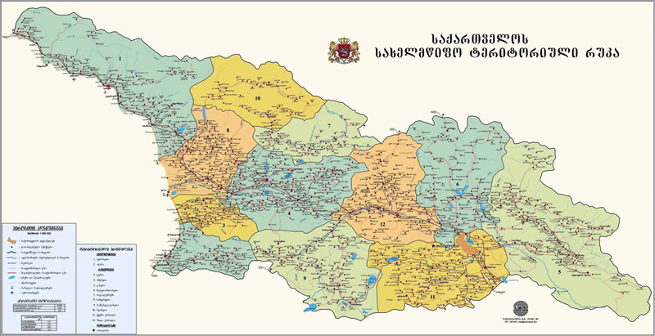
Rights and Freedoms - Union N.L.E.
Monitoring of Teacher Trainings in Georgia
2011-2012 years 7000 1st grade teachers in Georgia have been trained on how to use the Bukis through the Master Teacher Program (38 Master Teachers) in 40 regional centers

Slide 4



Rights and Freedoms - Union N.L.E.
Monitoring deployment of 1:1 Education in Georgia
Was printed 7,000 Manuals for
teacher trainings
Was printed 110,000 manuals for
Parents
Was Localized Skoool Content the most interactive educational source available on the internet for Georgian students.
This interactive website provides The bundle of lessons, assessments and revision sheets for chemistry, biology, mathematics and English lesson. http://www.skoool.ge

Slide 5
Rights and Freedoms - Union N.L.E.
Monitoring of Teacher Trainings in Georgia
Deployment Research Results:
School Director research
How are teachers using Bukies
during learning period?

Slide 6
Rights and Freedoms - Union N.L.E.
Monitoring deployment of 1:1 Education in Georgia
How do you assess the implementation of the Buki project in to the learning process?
Answer Options | Response Percent | Response Count
Successful | 84.0% | 390
Partly successful | 14.0% | 65
Unsuccessful | 2.0% | 9
Difficult to answer | 0.0% | 0
answered question |  | 464
skipped question |  | 0
How often do teachers use Buki in the learning process?
Answer Options | Response Percent | Response Count
Once a week | 4.0% | 19
Several Times a week | 55.0% | 255
Every day | 41.0% | 190
Do not use | 0.0% | 0
answered question |  | 464
skipped question |  | 0
*For research of training evaluation was used Surveymonkey source: http://www.surveymonkey.net/

Slide 7
Rights and Freedoms - Union N.L.E.
Monitoring deployment of 1:1 Education in Georgia
Does Buki help students to acquire relevant skills from the National Curriculum?
Answer Options | Response Percent | Response Count
It helps | 97.0% | 440
It does not help | 1.0% | 5
Difficult to answer | 2.0% | 9
answered question |  | 464
skipped question |  | 10
How would you evaluate Buki as a cross-disciplinary teaching tool?
Answer Options | Response Percent | Response Count
successful | 84.5% | 384
partly successful | 15.5% | 71
difficult to answer | 0.0% | 0
answered question |  | 464
skipped question |  | 9
*For research of training evaluation was used Surveymonkey source: http://www.surveymonkey.net/

Slide 8
Rights and Freedoms - Union N.L.E.
Monitoring deployment of 1:1 Education in Georgia
Student academic achievements resulted form the use of Buki
Answer Options | Response Percent | Response Count
improved significantly | 31.0% | 140
improved | 65.7% | 298
have not changed | 1.0% | 5
showed decrease | 1.0% | 5
difficult to answer | 1.0% | 5
answered question |  | 464
skipped question |  | 11
How difficult is it to learn from Buki?
Answer Options | Response Percent | Response Count
very easy | 24.2% | 112
easy | 50.5% | 234
normal | 25.3% | 117
difficult | 0.0% | 0
very difficult | 0.0% | 0
answered question |  | 464
skipped question |  | 1
*For research of training evaluation was used Surveymonkey source: http://www.surveymonkey.net/

Slide 9
Rights and Freedoms - Union N.L.E.
Monitoring deployment of 1:1 Education in Georgia
In what subjects teachers use Buki? (you can select more than one)
Answer Options | Response Percent | Response Count
Georgian language and literature | 96.5% | 434
Math | 93.5% | 421
English | 79.4% | 357
Natural Sciences | 82.0% | 369
applied arts | 83.4% | 375
music | 68.0% | 306
answered question |  | 464
skipped question |  | 14
*For research of training evaluation was used Surveymonkey source: http://www.surveymonkey.net/

Slide 10
Rights and Freedoms - Union N.L.E.
Monitoring deployment of 1:1 Education in Georgia
How many lessons a day incoporates use of Buki?
Answer Options | Response Percent | Response Count
Only one lesson | 10.5% | 48
2 lessons | 41.1% | 189
3 lessons | 33.7% | 155
All lessons | 14.7% | 67
None | 0.0% | 0
answered question |  | 464
skipped question |  | 5
*For research of training evaluation was used Surveymonkey source: http://www.surveymonkey.net/

Slide 11
Rights and Freedoms - Union N.L.E.
Monitoring deployment of 1:1 Education in Georgia
What challenges do children encounter with Buki?
Answer Options |  | Response Percent | Response Count
Battery is low |  | 53.9% | 244
Had difficulties learning how to use Buki |  | 6.7% | 30
Software issues |  | 14.6% | 66
Technical damage |  | 39.3% | 178
Other |  | 10.1% | 46
answered question |  |  | 464
skipped question |  |  | 11
*For research of training evaluation was used Surveymonkey source: http://www.surveymonkey.net/

Slide 12
Rights and Freedoms - Union N.L.E.
Monitoring deployment of 1:1 Education in Georgia
Other Challenges
connection between student and teacher computers
carrying Buki from home to school
program cannot be connected in time, which creates issues in lesson planning and time management
needs to much time for the set up, program often stops responding
viewing issues due to the small monitor size
Buki programs are in Georgian, which creates challenges for non-Georgian teachers and students
students' computers work with varying speed from the second half of the academic year, programs often stop responding; this creates challenges in the learning process
students bring computers with software issues from home
technical and physical damage to the computers; improper use of Buki at home
parents install new programs that affect the Buki programs that overload the system

Slide 13
Rights and Freedoms - Union N.L.E.
Monitoring deployment of 1:1 Education in Georgia
What are the challenges with launching/using Buki at schools?
Answer Options |  | Response Percent | Response Count
No challenges with launching the Buki project |  | 54.6% | 251
Teachers had difficult time using Buki in class |  | 7.2% | 33
Children had difficulties in learning how to use Buki |  | 2.1% | 10
Parents were not involved in the learning process |  | 17.5% | 80
lack of time for working on Buki |  | 17.5% | 80
technical issues |  | 25.8% | 118
difficult to answer |  | 4.1% | 19
other |  | 2.2% | 10
answered question |  |  | 464
skipped question |  |  | 5
Other Challenges
not all parents are not involved in the learning process
small hard drive space causes difficulties in storing files and the users have to frequently update the system
Router cannot transfer video files in a timely manner.
students damage Buki at home
*For research of training evaluation was used Surveymonkey source: http://www.surveymonkey.net/

Slide 14
Rights and Freedoms - Union N.L.E.
Monitoring deployment of 1:1 Education in Georgia
What is the level of parent involvement in the implementation of the project?
Answer Options | Response Percent | Response Count
full | 29.0% | 135
partial | 57.0% | 264
inadequate | 10.0% | 46
not involved | 4.0% | 19
answered question |  | 464
skipped question |  | 0
The role of the Education system in the implementation of the project
Answer Options | Response Percent | Response Count
full | 86.6% | 399
partial | 11.3% | 52
inadequate | 1.0% | 5
other | 1.1% | 5
answered question |  | 464
skipped question |  | 3
*For research of training evaluation was used Surveymonkey source: http://www.surveymonkey.net/

Slide 15
Rights and Freedoms - Union N.L.E.
Monitoring of Teacher Trainings in Georgia
Deployment Research Results:
Teacher research
How are teachers using Bukies
during learning period?

Slide 16
Rights and Freedoms - Union N.L.E.
Monitoring deployment of 1:1 Education in Georgia
How do you evaluate introducing Buki with the first graders?
Answer Options | Response Percent | Response Count
Successful | 91.1% | 1533
Partly successful | 8.9% | 150
Unsuccessful | 0.0% | 0
Difficult to answer | 0.0% | 0
answered question |  | 1683
skipped question |  | 0
How often do you use Buki in the learning process?
Answer Options | Response Percent | Response Count
Once a week | 4.5% | 76
Several times a week | 56.8% | 956
Every day | 38.6% | 650
I don't use it | 0.0% | 0
answered question |  | 1683
skipped question |  | 1
*For research of training evaluation was used Surveymonkey source: http://www.surveymonkey.net/

Slide 17
Rights and Freedoms - Union N.L.E.
Monitoring deployment of 1:1 Education in Georgia
Does Buki help students to acquire relevant skills from the National Curriculum?
Answer Options | Response Percent | Response Count
It helps | 97.8% | 1645
It does not help | 0.0% | 0
Difficult to answer | 2.2% | 37
answered question |  | 1683
skipped question |  | 1
How would you evaluate Buki as a cross-disciplinary teaching tool?
Answer Options | Response Percent | Response Count
Successful | 84.4% | 1420
Partly successful | 15.6% | 263
Difficult to answer | 0.0% | 0
answered question |  | 1683
skipped question |  | 0
*For research of training evaluation was used Surveymonkey source: http://www.surveymonkey.net/

Slide 18
Rights and Freedoms - Union N.L.E.
Monitoring deployment of 1:1 Education in Georgia
Student academic achievements resulted form the use of Buki
Answer Options | Response Percent | Response Count
Improved significantly | 29.5% | 493
Improved | 68.2% | 1140
Have not changed | 2.3% | 38
Showed decrease | 0.0% | 0
Difficult to answer | 0.0% | 0
answered question |  | 1683
skipped question |  | 11
How difficult is it to learn from Buki?
Answer Options | Response Percent | Response Count
Very easy | 53.3% | 887
Easy | 37.8% | 629
Normal | 8.9% | 148
Difficult | 0.0% | 0
Very difficult | 0.0% | 0
answered question |  | 1683
skipped question |  | 19
*For research of training evaluation was used Surveymonkey source: http://www.surveymonkey.net/

Slide 19
Rights and Freedoms - Union N.L.E.
Monitoring deployment of 1:1 Education in Georgia
In which subjects have you used Buki? ( can select more than one)
Answer Options | Response Percent | Response Count
Georgian language and literature | 88.9% | 1466
Math | 88.9% | 1466
English | 55.6% | 917
Natural Sciences | 64.4% | 1062
applied arts | 68.9% | 1136
music | 40.0% | 660
answered question |  | 1683
skipped question |  | 34
*For research of training evaluation was used Surveymonkey source: http://www.surveymonkey.net/

Slide 20
Rights and Freedoms - Union N.L.E.
Monitoring deployment of 1:1 Education in Georgia
How many lessons a day incoporates use of Buki?
Answer Options | Response Percent | Response Count
Only one lesson | 11.1% | 183
2 lessons | 55.6% | 916
3 lessons | 28.9% | 476
All lessons | 4.4% | 73
None | 0.0% | 0
answered question |  | 1683
skipped question |  | 35
How long do you use Buki during the lesson?
Answer Options |  | Response Percent | Response Count
10 min |  | 11.1% | 185
20 min |  | 60.0% | 1001
30 min |  | 28.9% | 482
40 min |  | 0.0% | 0
other |  | 0.0% | 0
answered question |  |  | 1683
skipped question |  |  | 15
*For research of training evaluation was used Surveymonkey source: http://www.surveymonkey.net/

Slide 21
Rights and Freedoms - Union N.L.E.
Monitoring deployment of 1:1 Education in Georgia
What challenges do children encounter with Buki?
Answer Options |  | Response Percent | Response Count
Battery is low |  | 72.1% | 1162
Had difficulties learning how to use Buki |  | 0.0% | 0
Software issues |  | 16.3% | 263
Technical damage |  | 41.9% | 675
Other |  | 4.7% | 76
answered question |  |  | 1683
skipped question |  |  | 71
Other Challenges
Connection between student and teacher computers
Carrying Buki from home to school.
Children frequently bring Buki from home with software issues.
Parents install new programs which overloads Buki
Wi-Fi issue
*For research of training evaluation was used Surveymonkey source: http://www.surveymonkey.net/

Slide 22
Rights and Freedoms - Union N.L.E.
Monitoring deployment of 1:1 Education in Georgia
What are the challenges with launching/using Buki at schools?
Answer Options |  | Response Percent | Response Count
No challenges with launching the Buki project |  | 55.6% | 904
Teachers had difficult time using Buki in class |  | 0.0% | 0
Children had difficulties in learning how to use Buki |  | 0.0% | 0
Parents were not involved in the learning process |  | 11.1% | 180
lack of time for working on Buki |  | 11.1% | 180
technical issues |  | 31.1% | 506
difficult to answer |  | 2.2% | 36
other |  | 0.0% | 0
answered question |  |  | 1683
skipped question |  |  | 57
*For research of training evaluation was used Surveymonkey source: http://www.surveymonkey.net/

Slide 23
Rights and Freedoms - Union N.L.E.
Monitoring deployment of 1:1 Education in Georgia
Other Challenges
Small hard drive space causes difficulties in storing files and the users have to frequently update the system
Router cannot transfer video files in a timely manner.
Students damage Buki at home
program cannot be connected in time, which creates issues in lesson planning and time management
maintenance and technical support with Buki
viewing issues due to the small monitor size
Students bring computers with software issues from home
technical and physical damage to the computers;
parents install new programs that affect the Buki programs that overload the system
*For research of training evaluation was used Surveymonkey source: http://www.surveymonkey.net/

Slide 24
Rights and Freedoms - Union N.L.E.
Monitoring deployment of 1:1 Education in Georgia
Gained knowledge on the trainings is helping in the learning process
Answer Options |  | Response Percent | Response Count
Stronly agree |  | 58.23% | 971
Agree |  | 38.86% | 653
Disagree |  | 1.37% | 22
Strongli Disagree |  | 0.95% | 16
Have no Idea |  | 0.59% | 10
answered question |  |  | 1683
skipped question |  |  | 11
Do you use Classroom management software
Answer Options |  | Response Percent | Response Count
Yes |  | 43.50% | 727
No |  | 32.20% | 532
Often |  | 8.70% | 141
Rerely |  | 15.60% | 258
answered question |  |  | 1683
skipped question |  |  | 25
*For research of training evaluation was used Surveymonkey source: http://www.surveymonkey.net/

Slide 25
Rights and Freedoms - Union N.L.E.
Monitoring deployment of 1:1 Education in Georgia
Do you use educational software for teachers and students?
Answer Options |  | Response Percent | Response Count
Yes |  | 79.30% | 1320
No |  | 0.20% | 4
Often |  | 20.00% | 333
Rerely |  | 0.50% | 8
answered question |  |  | 1683
skipped question |  |  | 18
How Ofter do you need technical support during the lesson?
Answer Options |  | Response Percent | Response Count
All time |  | 79.30% | 130
Often |  | 0.20% | 258
Rerely |  | 20.00% | 1245
Never |  | 0.50% | 47
answered question |  |  | 1683
skipped question |  |  | 3
*For research of training evaluation was used Surveymonkey source: http://www.surveymonkey.net/

Slide 26
Rights and Freedoms - Union N.L.E.
Monitoring deployment of 1:1 Education in Georgia
What Technical support do you need most often?
Answer Options |  | Response Percent | Response Count
Wi-Fi Connection issues |  | 72.1% | 1208
Software issues |  | 7.5% | 126
Battery Charging |  | 28.2% | 474
Other |  | 1.7% | 29
answered question |  |  | 1683
skipped question |  |  | 7
*For research of training evaluation was used Surveymonkey source: http://www.surveymonkey.net/

Slide 27
Rights and Freedoms - Union N.L.E.
Monitoring deployment of 1:1 Education in Georgia
What is the level of parent involvement in the implementation of the project
Answer Options | Response Percent | Response Count
full | 29.0% | 488
partial | 57.0% | 959
inadequate | 10.0% | 168
not involved | 4.0% | 67
answered question |  | 1683
skipped question |  | 0
Role of Education system in the implementation of the project
Answer Options | Response Percent | Response Count
full | 86.6% | 1455
partial | 11.3% | 190
inadequate | 1.0% | 17
other | 1.1% | 18
answered question |  | 1683
skipped question |  | 3
*For research of training evaluation was used Surveymonkey source: http://www.surveymonkey.net/

Slide 28
Rights and Freedoms - Union N.L.E.
Monitoring deployment of 1:1 Education in Georgia
What additional support do you need from the education system for the project's success? (please select several answers)
Answer Options |  | Response Percent | Response Count
Recommendations |  | 61.80% | 1040
Adapted curriculum projects |  | 80.00% | 1346
Additional trainings |  | 43.00% | 723
Newses |  | 3.00% | 51
Teacher portal |  | 75.00% | 1262
others |  | 0.80% | 12
answered question |  |  | 1683
skipped question |  |  | 11
*For research of training evaluation was used Surveymonkey source: http://www.surveymonkey.net/

Slide 29
Rights and Freedoms - Union N.L.E.
Monitoring of Teacher Trainings in Georgia
Visiting Schools

Slide 30
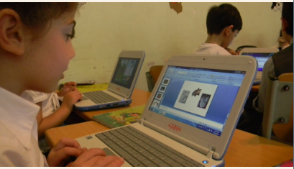
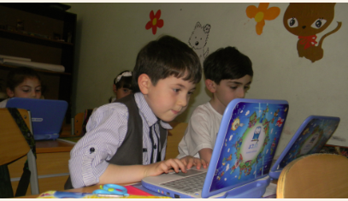
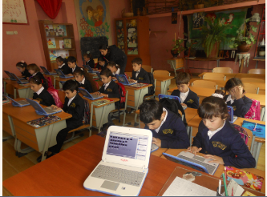
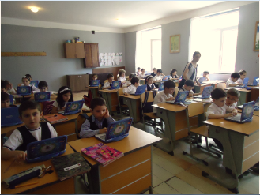
Rights and Freedoms - Union N.L.E.
Monitoring of Teacher Trainings in Georgia
Kutaisi
Kutaisi
Khulo
Gori

Slide 31
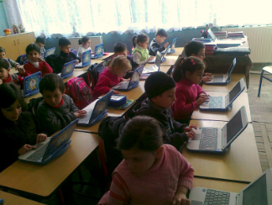
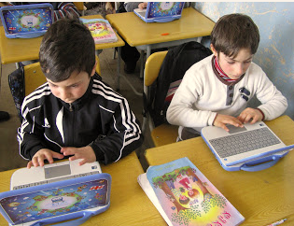
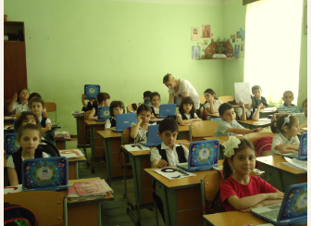
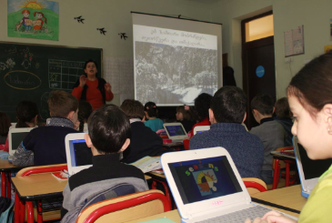
Rights and Freedoms - Union N.L.E.
Monitoring deployment of 1:1 Education in Georgia
Telavi
Gardabani
Akhmeta
Signagi

Slide 32
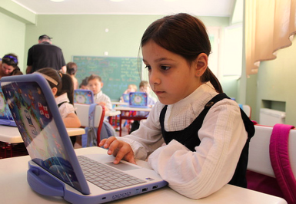
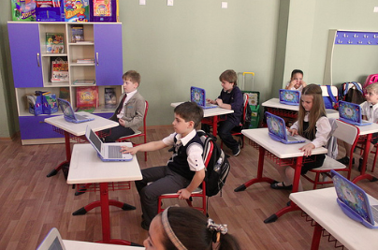
Rights and Freedoms - Union N.L.E.
Monitoring deployment of 1:1 Education in Georgia
Tbilisi #169
Tbilisi #169

Slide 33
Rights and Freedoms - Union N.L.E.
Monitoring deployment of 1:1 Education in Georgia
Highlighted Issues

Slide 34
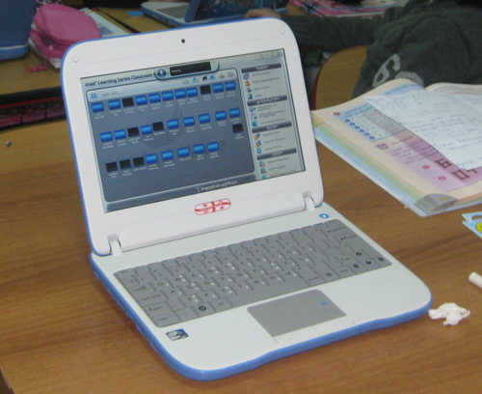
Rights and Freedoms - Union N.L.E.
Monitoring deployment of 1:1 Education in Georgia
Battery life — the battery work lasts only 35-50 minutes.
Sometimes teachers are not able to use it on the second lesson.
Buki screen is too small for teachers, it’s hard
to create content on it. It’s small for mythware
screen resolution. We can observe it on the photo.
Wi-Fi connection problems
Small hard drive
Teachers can’t share from their desktops big files and slideshows. In addition, they expressed frustration with the slow refresh rates (10s of seconds) when they share their desktop and sending quiz to students.

Slide 35
Rights and Freedoms - Union N.L.E.
Monitoring deployment of 1:1 Education in Georgia
Students damage Buki at home or bring computers with software issues from home.
Parents install new programs that affect the Buki programs that overload the system.
Technical support from IT managers.

Slide 36
Rights and Freedoms - Union N.L.E.
Monitoring of Teacher Trainings in Georgia
Teacher Trainings
July-September 2012

Slide 37
Rights and Freedoms - Union N.L.E.
Monitoring of Teacher Trainings in Georgia
Training Timetable Scheduling
Master Trainer | Region | Groups | Teachers per group | Total
Shorena Mikaberidze | Bolnisi | 4 | 14 | 56
 | Tetritskaro | 3 | 12 | 36
 | Rustavi | 2 | 14 | 28
Manana Kapanadze | Khashuri | 4 | 13 | 52
 | Kharagauli | 3 | 14 | 42
Irina Markozashvili | Tbilisi | 6 | 12 | 72
 | Marneuli | 2 | 14 | 28
Zaza Mokhvashi | Tbilisi | 8 | 13 | 104
Rusudan Markozashvili | Tbilisi | 8 | 13 | 104
Maia Bazgadze | Tbilisi | 8 | 14 | 112
Teona Lotikashvili | Tbilisi | 8 | 13 | 104
Diana Miqadze | Tbilisi | 8 | 13 | 104
Natia Mumladze | Tbilisi | 5 | 13 | 65
Inga Kakhiani | Imereti | 9 | 15 | 135
Megi Kapanadze | Imereti | 10 | 13 | 130
Mari Marchiladze | Imereti | 10 | 14 | 140
Nodar Tsagareishvili | Imereti | 8 | 15 | 120
Gogita Mokhvashi | Samegrelo | 10 | 13 | 130
Nona Qadaia | Samegrelo | 8 | 13 | 104
Eka Samurkasovi | Poti | 7 | 12 | 84

Slide 38
Rights and Freedoms - Union N.L.E.
Monitoring of Teacher Trainings in Georgia
Training timetable scheduling
Master Trainer | Region | Groups | Teachers per group | Total
Levan Tsulaia | Samegrelo | 8 | 13 | 104
Lia Navrozashvili | Gardabani | 9 | 14 | 126
Marekhi Jeladze | Rustavi | 6 | 13 | 78
 | Svaneti | 3 | 11 | 33
Lili Zoidze | Tsalka | 3 | 14 | 42
 | Gardabani | 3 | 13 | 39
 | Dmanisi | 3 | 13 | 39
Marine Chitadze | Gori | 5 | 14 | 70
 | TianeTi | 2 | 9 | 18
Nino Mgebrishvili | Gori | 2 | 12 | 24
 | Dusheti | 4 | 13 | 52
Nana Edisherashvili | Gori | 6 | 14 | 84
Elene BeTlemishvili | Gori | 2 | 13 | 26
 | Mtskheta | 3 | 12 | 36
 | Kazbegi | 1 | 10 | 10
Natia Tsintsadze | QobuleTi | 4 | 15 | 60
 | Batumi | 5 | 13 | 65
Khatuna Lortkifanidze | Khelvachauri | 8 | 13 | 104
Zurab Kekelidze | Khulo | 6 | 13 | 78
 | Qeda | 2 | 13 | 26

Slide 39
Rights and Freedoms - Union N.L.E.
Monitoring of Teacher Trainings in Georgia
Training timetable scheduling
Master Trainer | Region | Groups | Teachers per group | Total
Maka Aframishvili | Axaltsikhe | 2 | 13 | 26
 | Akhalqalaqi | 3 | 14 | 42
 | Aspindza | 3 | 12 | 36
Nino Kokilashvili | Kakheti | 7 | 14 | 98
Qetevan Inanishvili | Signagi | 4 | 14 | 56
Khatuna Markozashvili | Akhmeta | 3 | 13 | 39
 | Tsageri | 2 | 14 | 28
 | Kakheti | 2 | 11 | 22
Zurab Dzuliashvili | Telavi | 4 | 11 | 44
 | OzurgeTi | 2 | 13 | 26
Dimitri Popovi | Gurjaani | 3 | 13 | 39
 | Svaneti | 3 | 14 | 42
 | Ninotsminda | 3 | 14 | 42
Marekhi Natenadze | Akhalqalaqi | 4 | 14 | 56
 | Adigeni | 2 | 13 | 26
 | Borjomi | 2 | 13 | 26
 | Akhaltsixe | 2 | 13 | 26

Slide 40
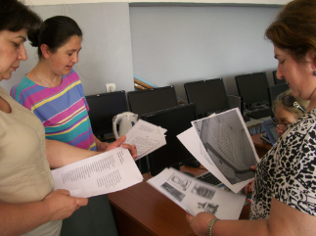
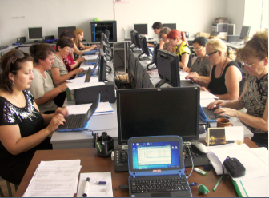
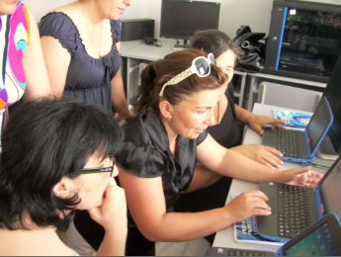
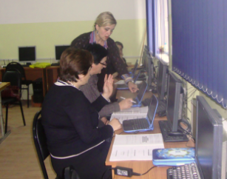
Rights and Freedoms - Union N.L.E.
Monitoring of Teacher Trainings in Georgia
Gardabani
Martkopi
Telavi
Mtskheta

Slide 41
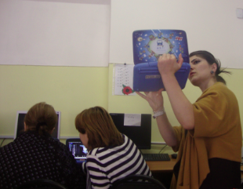
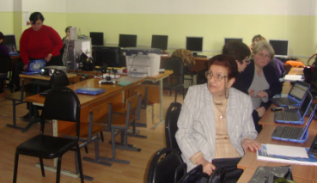
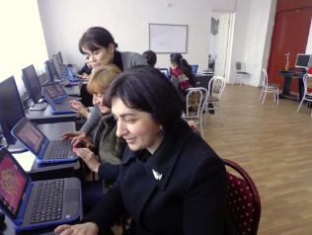
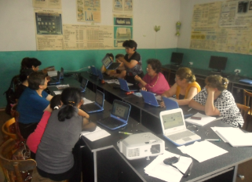
Rights and Freedoms - Union N.L.E.
Monitoring of Teacher Trainings in Georgia
Tbilisi
Tbilisi
Kutaisi
Ninotsminda

Slide 42
Rights and Freedoms - Union N.L.E.
Monitoring of Teacher Trainings in Georgia
Teacher Training Evaluation
Research Results
*For research of training evaluation was used Surveymonkey source: http://www.surveymonkey.net/

Slide 43
Rights and Freedoms - Union N.L.E.
Monitoring of Teacher Trainings in Georgia
Learned what I needed to know.
Answer Options | Response Percent | Response Count
Strongly Agree | 54.8% | 235
Agree | 43.6% | 187
No Opinion | 0.0% | 0
Disagree | 1.2% | 5
Strongly Disagree | 0.5% | 2
answered question |  | 429
skipped question |  | 2
Was exactly the right amount of time
Answer Options | Response Percent | Response Count
Strongly Agree | 41.7% | 178
Agree | 34.9% | 149
No Opinion | 1.2% | 5
Disagree | 15.7% | 67
Strongly Disagree | 6.6% | 28
answered question |  | 427
skipped question |  | 4
*For research of training evaluation was used Surveymonkey source: http://www.surveymonkey.net/

Slide 44
Rights and Freedoms - Union N.L.E.
Monitoring of Teacher Trainings in Georgia
Maintained an appropriate balance between lecture and hands-on activities
Answer Options | Response Percent | Response Count
Strongly Agree | 41.4% | 179
Agree | 52.1% | 225
No Opinion | 2.1% | 9
Disagree | 3.0% | 13
Strongly Disagree | 1.4% | 6
answered question |  | 432
skipped question |  | 10
Met my expectations in terms of difficulty level
Answer Options | Response Percent | Response Count
Strongly Agree | 45.9% | 194
Agree | 44.7% | 189
No Opinion | 0.7% | 3
Disagree | 7.6% | 32
Strongly Disagree | 1.2% | 5
answered question |  | 423
skipped question |  | 9
*For research of training evaluation was used Surveymonkey source: http://www.surveymonkey.net/

Slide 45
Rights and Freedoms - Union N.L.E.
Monitoring of Teacher Trainings in Georgia
Demonstrated strong knowledge of all course content
Answer Options | Response Percent | Response Count
Strongly Agree | 56.8% | 239
Agree | 37.3% | 157
No Opinion | 2.9% | 12
Disagree | 1.2% | 5
Strongly Disagree | 1.9% | 8
answered question |  | 421
skipped question |  | 11
Training was well-organized and prepared for class
Answer Options | Response Percent | Response Count
Strongly Agree | 46.7% | 198
Agree | 49.8% | 211
No Opinion | 0.7% | 3
Disagree | 1.2% | 5
Strongly Disagree | 1.7% | 7
answered question |  | 424
skipped question |  | 8
*For research of training evaluation was used Surveymonkey source: http://www.surveymonkey.net/

Slide 46
Rights and Freedoms - Union N.L.E.
Monitoring of Teacher Trainings in Georgia
Was enthusiastic and engaging
Answer Options | Response Percent | Response Count
Strongly Agree | 57.0% | 245
Agree | 40.9% | 176
No Opinion | 0.7% | 3
Disagree | 0.9% | 4
Strongly Disagree | 0.5% | 2
answered question |  | 430
skipped question |  | 2
I’d recommend this course to others
Answer Options | Response Percent | Response Count
Strongly Agree | 59.5% | 256
Agree | 35.3% | 152
No Opinion | 2.1% | 9
Disagree | 2.1% | 9
Strongly Disagree | 0.9% | 4
answered question |  | 430
skipped question |  | 11
*For research of training evaluation was used Surveymonkey source: http://www.surveymonkey.net/

Slide 47
Rights and Freedoms - Union N.L.E.
Monitoring of Teacher Trainings in Georgia
Learned methods will use in my practice work
Answer Options | Response Percent | Response Count
Strongly Agree | 58.1% | 248
Agree | 39.1% | 167
No Opinion | 1.9% | 8
Disagree | 0.0% | 0
Strongly Disagree | 0.9% | 4
answered question |  | 427
skipped question |  | 5
Would Like to get news and updates
Answer Options | Response Percent | Response Count
Strongly Agree | 57.4% | 245
Agree | 39.1% | 167
No Opinion | 0.9% | 4
Disagree | 1.4% | 6
Strongly Disagree | 1.2% | 5
answered question |  | 427
skipped question |  | 5
*For research of training evaluation was used Surveymonkey source: http://www.surveymonkey.net/

Slide 48
Rights and Freedoms - Union N.L.E.
Monitoring deployment of 1:1 Education in Georgia
Thank you!
monitoring@freedom.org.ge

